Slide 1
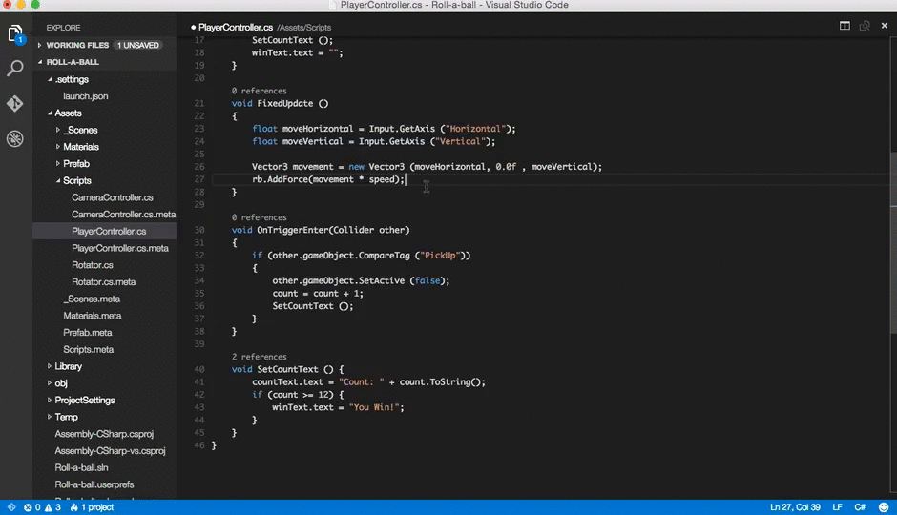
A Look Inside @code
A Deep Dive in Building Extensions
Jason Poon Senior Software Engineer @ Microsoft
Notes:
- How many of you use VS Code or know what it is?
(if they don't, ask what they are using)
Buying a mattress analogy (8 hours a day)
As a developer, I spend a fair bit of my time writing code (the time I spend coding isn’t as much as I want), but that’s a rant for some other time. It’s important that you use the best tools that work for you. When VS Code came out, it became my primary editor for a multitude of reasons that I'll explain

Slide 2
You will leave here knowing…
01
The story behind VS Code
02
Debugging node.js applications
03
Develop, debug, test, publish an extension
04
Tips n’ tricks
Notes:
- VS Code has been my primary editor for a multitude of reasons that I'll explain.
- I don't have very many slides as I want to focus on showing you rather than telling you the awesome-ness of VS Code
At the end of the session, I hope to impart with you
- Knowing what VS Code is and how you can integrate it into your current development workflow
- How to debug node.js application with VS Code
- and if you want to extend VS Code's capability, we'll walkthrough the whole development cycle of creating and publishing an extension
- although the way, share tips n' tricks on using VS Code

Slide 3
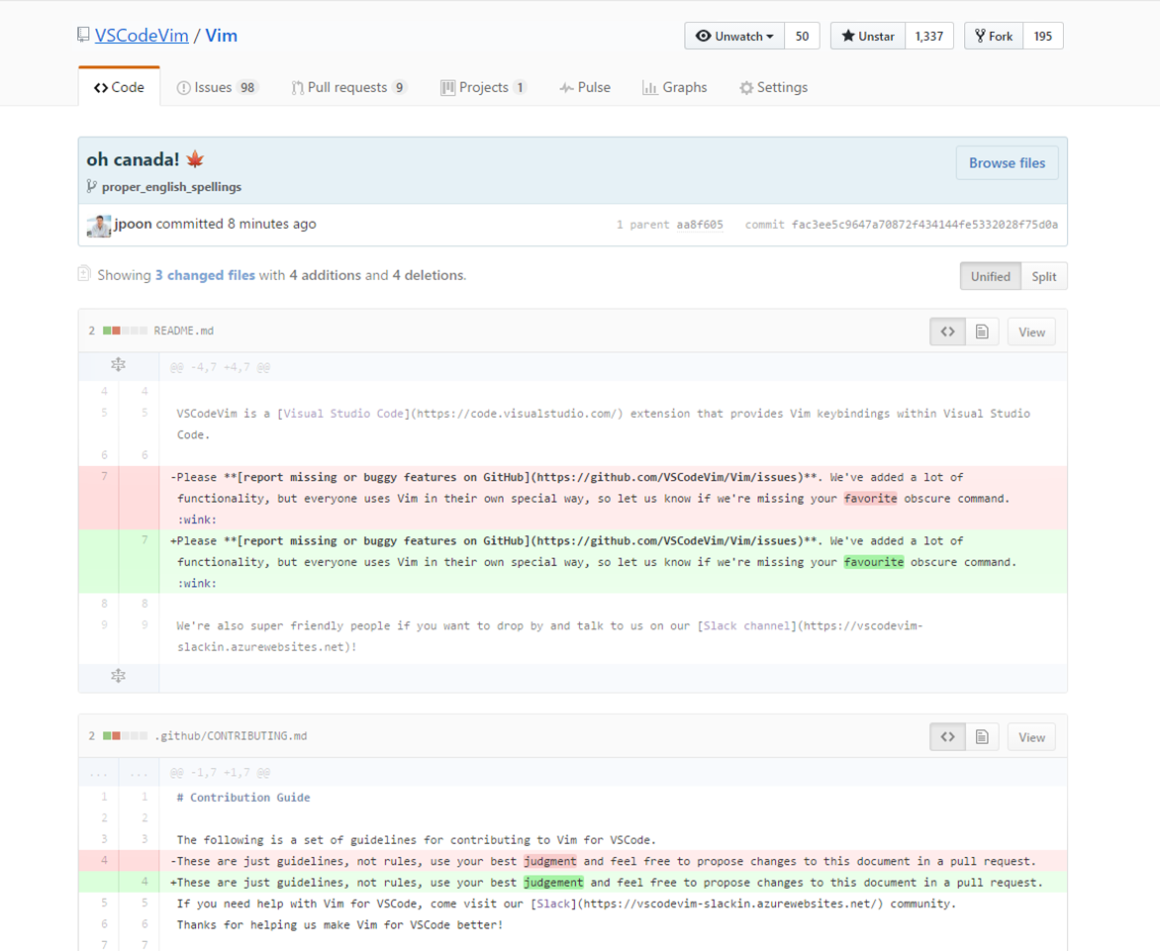

Slide 4



Notes:
A tool that combines simplicity of a code editor with what developers need to accomplish code/build/test/debug/commit lifecycle
Draw code editor vs IDE scale (vim, emacs, notepad++, eclipse, xcode, visual studio, sublime, atom)
Within the Visual Studio family, it is also the first cross-platform development tool
Same experience across all platforms

Slide 5

Developed in the Open
Microsoft ❤ Open Source
https://octoverse.github.com/
Open Source
https://github.com/Microsoft/vscode/
Open to community contributions
Community Driven
Open process: roadmap, design docs, etc
Monthly Iteration Plans
Download
Release: https://code.visualstudio.com/download
Insiders: https://code.visualstudio.com/insiders
Notes:
Microsoft was found to be the organization with the most open source contributors.
Announced at the Microsoft Build conference April 2015
Open sourced under MIT on GitHub Nov 2015
VS Code was one of the most contributed to projects
PRs are extremely welcome on the project and with each release, they meticulously thank each and every one.
Full transparency with the planning and roadmap.
Draw feedback loop: (1) Dev Team -> Transparency -> (2) Community -> Feedbacks

Slide 6






Notes:
Clue:
One of the 4 authors of a book called “Design Patterns” (Gang of Four)
Distinguished Engineer @ MSFT
He joined Microsoft with a vision of a new paradigm for online developer tooling
a development experience that is in the browser that makes you forget you are in a browser

Slide 7
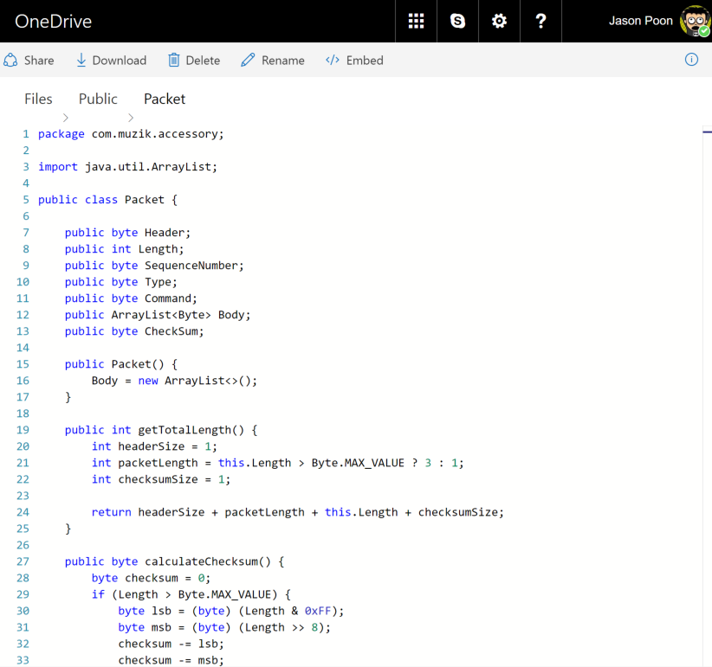
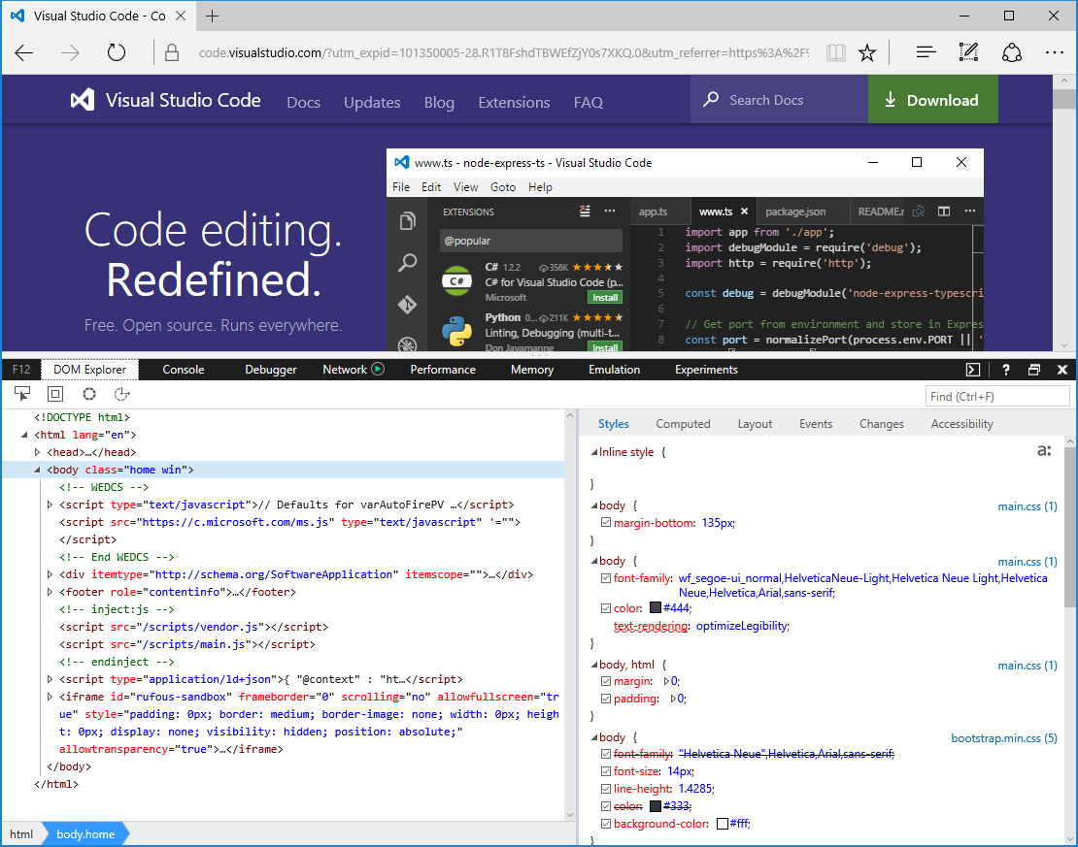
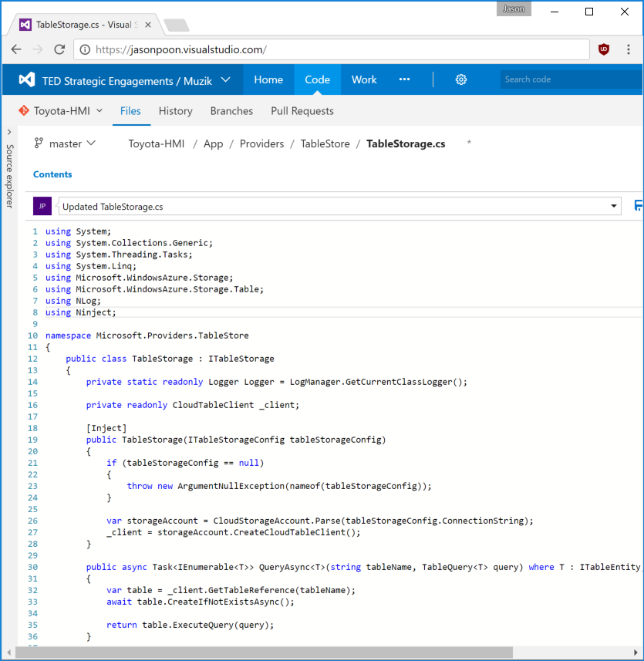
Notes:
Monaco cloud editor
Features
Intellisense (Smart completions)
Syntax Highlight
Code Navigation

Slide 8

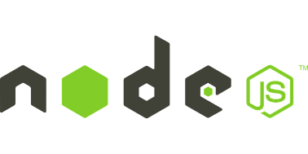










node.js
Monaco
TypeScript
Electron
Extensions
Extensions
Extensions
Notes:
what’s amazing about vscode is that it’s comprised of these tiny build blocks.
Add them upon each other and creates such an amazing product
With each extension as another building block, you can add however many you want to customize or optimize your development workflow

Slide 9
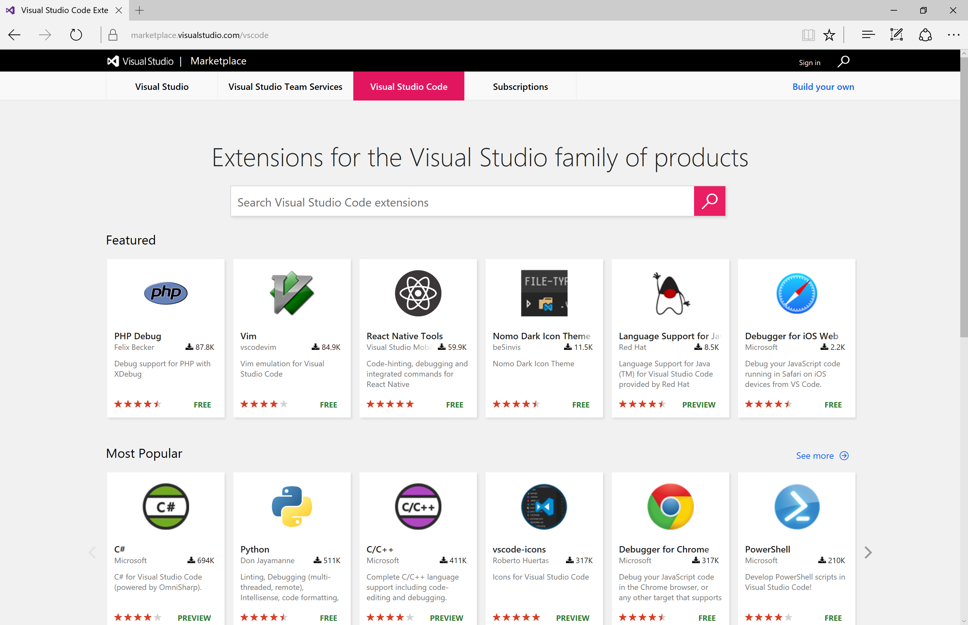



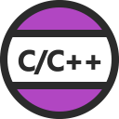


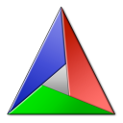



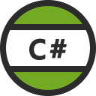


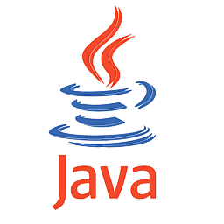




Extensions, Extensions, Extensions!
Language
Debuggers
Tools
JS, TS, CSS, HTML
Node.js
Notes:
Language
Shipped out of the box, VS Code understands JS, TS, CSS, HTML
Other language support is available through the extension marketplace
Debuggers
Built-in Node.js debugger and can debug any language that gets transpiled to JS (TS)
Tools
Help you be more efficient

Slide 10













Extensions, Extensions, Extensions!
Notes:
However, as you start stacking each of these building blocks, as a whole, it might become unwieldy and topple over.
In order to prevent extensions from affecting the startup performance and the overall stability of VS Code itself, extensions are run in a separate process called “extension host”. The extension host is a node.js process which means for your extension, you can use any node api or existing npm module when implementing extension.
Running extensions as a separate process allows VS Code to control the APIs exposed to the extenders.

Slide 11





Extensions, Extensions, Extensions!
Language Server Protocol https://github.com/Microsoft/language-server-protocol
Debug Protocol https://github.com/Microsoft/vscode-debugadapter-node
Notes:
There are 2 special cases for extensions.
If you are developing a language or a debug service, instead of coding against the extension API, there are predefined protocols that your extension can adhere to.
Protocol can be adapted in other editors or IDEs such that one implementation of the language/debug protocol can service multiple IDEs

Slide 12

Let’s Build It!
TypeWriter Extension
Make typewriter sounds as I type [a-zA-Z]

Slide 13
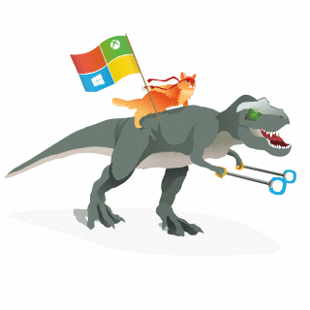



Resources
Visual Studio Code https://code.visualstudio.com
Typewriter Extension https://github.com/jpoon/vscode-typewriter
Monaco Editor https://github.com/Microsoft/monaco-editor
VSCodeVim https://github.com/vscodevim/vim
Electron www.electron.atom.io
VS Code Tips and Tricks https://github.com/Microsoft/vscode-tips-and-trick
Jason Poon github.com/jpoon
@jasonthepoon
jason.poon@microsoft.com

